Slide 1
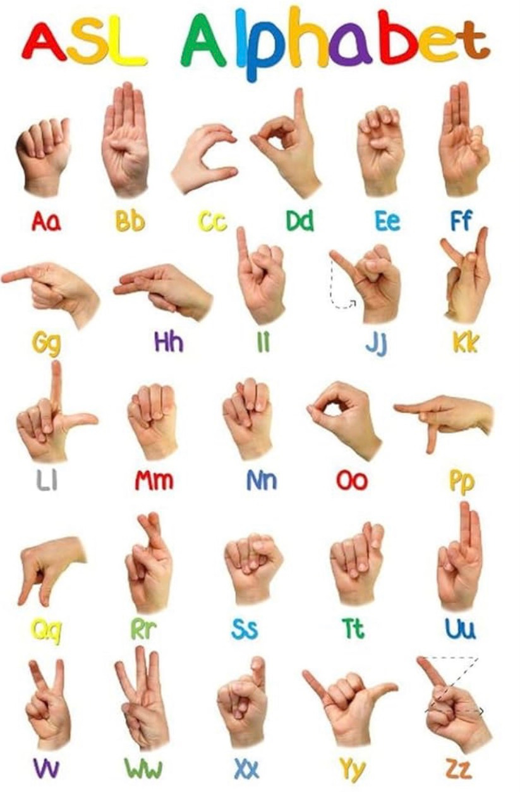
Final Deep Learning Project — ASL Recognition
American Sign Language recognition using a custom CNN, MobileNetV2 transfer learning, and a Streamlit deployment.
Student: Daryn
Course: Deep Learning
Notes:
1

Slide 2
Project Overview
The system accepts a hand-gesture image and predicts the correct ASL class. This is a supervised computer vision image-classification problem implemented with deep learning models and exposed via an interactive Streamlit app.
Scope
Models
Best Result
29 ASL classes (A–Z plus del, nothing, space)
Custom CNN baseline and MobileNetV2 transfer model
Top accuracy: 84.19% (Macro F1: 84.05%)
Notes:
2

Slide 3
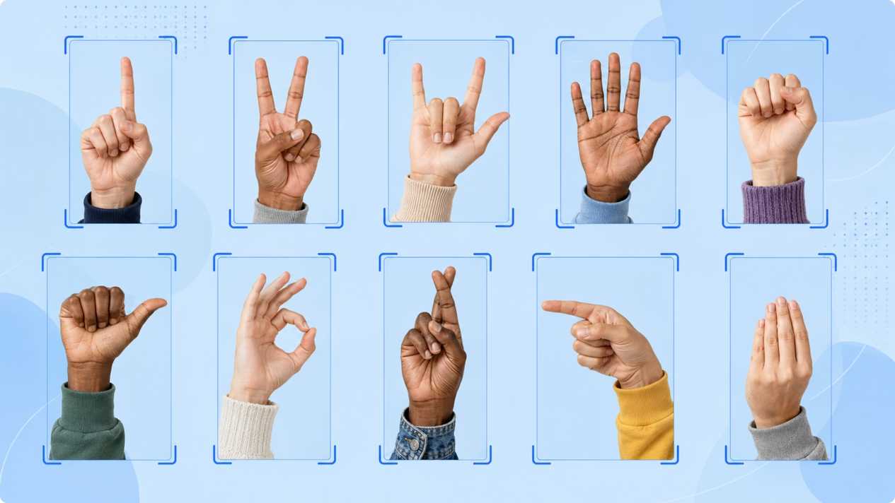
Dataset & Preprocessing
Dataset sourced from Kaggle: ASL alphabet with 29 classes (A–Z, del, nothing, space). Images were resized to 128×128 and pixel values normalized to [0,1]. A held-out validation set was preserved and kept clean to avoid any data leakage.
Validation data was not augmented to ensure an unbiased estimate of generalization.
Notes:
3

Slide 4
Training Robustness
Data augmentation was applied to the training set to improve model robustness to real-world variability. Augmentations were realistic and constrained to preserve label integrity.
Rotation
Zoom / Scale
Width/Height Shift
Brightness Variation
Accounts for tilted hands and camera angle variance.
Simulates distance changes and cropping.
Translates hands within the frame to reduce overfitting to centered poses.
Models lighting differences across capture conditions.
Notes:
4

Slide 5
Model 1 — Custom CNN (Baseline)
A compact convolutional neural network was implemented as the baseline. It serves both as a performance benchmark and a fast model for experimentation.
Architecture
Regularization
Output
Conv2D → BatchNorm → ReLU → MaxPool blocks (stacked)
Dropout layers and data augmentation to reduce overfitting
Fully connected head with Softmax over 29 classes
Notes:
5

Slide 6
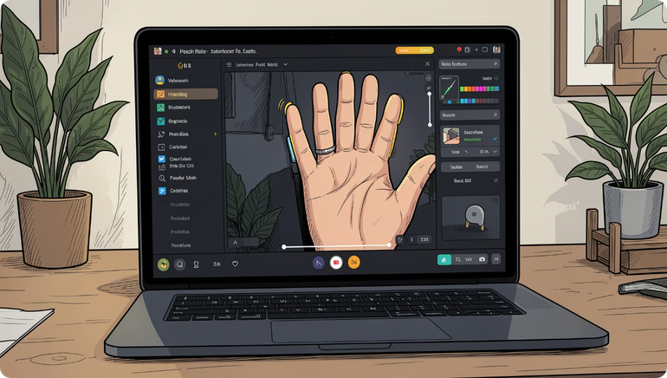

Model 2 — MobileNetV2 Transfer Learning
Transfer learning with MobileNetV2 (ImageNet pretrained) was used to improve representational power while keeping inference efficient for edge and mobile use-cases.
MobileNetV2 advantages:
Lightweight & low-latency for deployment
Pretrained low-level features accelerate convergence
Custom classification head fine-tuned on ASL dataset
Both models were evaluated on the same validation set for fair comparison.
Notes:
6

Slide 7

Results & Analysis
84.19%
82.36%
84.05%
Custom CNN
MobileNetV2
Macro F1
Top validation accuracy achieved
Close performance; better generalization on some classes
Balanced metric across all classes
Class-level observations
Best-recognized signs typically have distinctive finger configurations. Harder classes include signs with subtle differences (e.g., F vs S, L vs X) and non-manual cues like 'nothing' or 'space' which rely on context.
Main challenge: inter-class similarity in finger positions leads to misclassification among visually similar signs.
Notes:
7

Slide 8
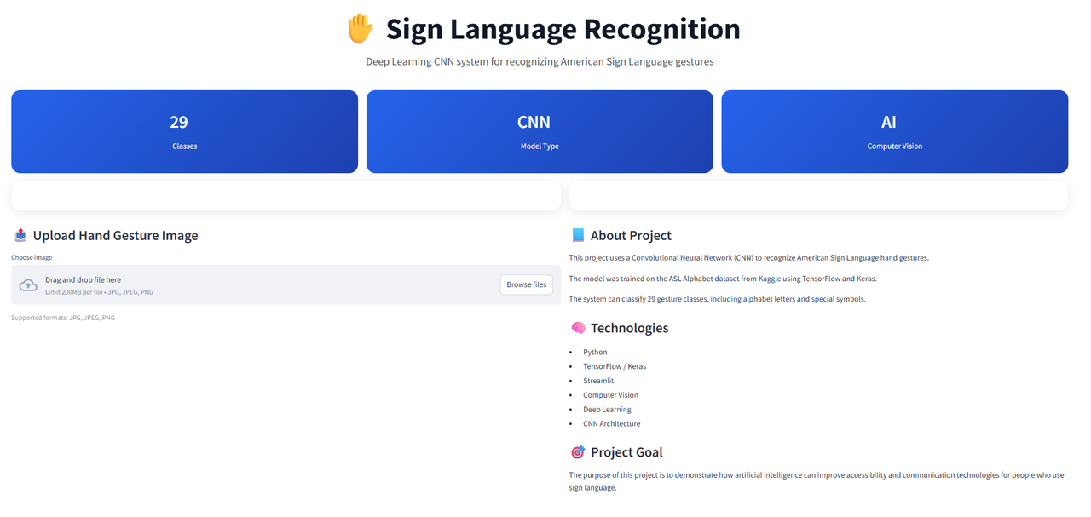

Deployment — Streamlit App
The trained model was integrated into a lightweight Streamlit interface for demo and usability testing. Typical user flow:
Upload or capture an ASL image
Run prediction (single image inference)
Display predicted sign and confidence scores
Optionally view top-k predictions and probability bar chart
Run command: streamlit run app.py
Notes:
8

Slide 9

Conclusion
This project demonstrates a complete deep learning pipeline: dataset → preprocessing → baseline CNN → transfer learning → evaluation → Streamlit deployment. Key achievements include model comparison, robust preprocessing, and a user-facing demo.
Notes:
9

